Slide 1
Dr.S.Paulraj
M.Sc., M.Phil.,B.Ed.,Ph.D.
Professor of Mathematics
Anna University Chennai

Slide 2
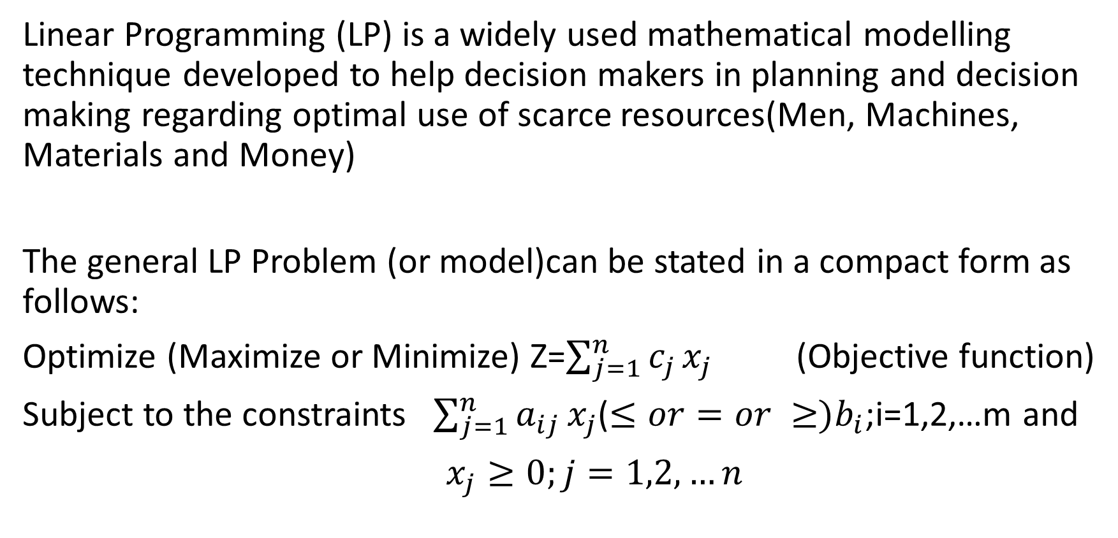
Introduction
Linear Programming (LP) is a widely used mathematical modelling technique developed to help decision makers in planning and decision making regarding optimal use of scarce resources(Men, Machines, Materials and Money)
The general LP Problem (or model)can be stated in a compact form as follows:
Optimize (Maximize or Minimize) Z=$\sum_{j=1}^{n}{c_{j}}x_{j }$ (Objective function)
Subject to the constraints $\sum_{j=1}^{n}{a_{ij}}x_{j}$($≤or=or ≥)b_{i}$;i=1,2,…m and
$x_{j}≥0;j=1,2,…n$

Slide 3
STEPS OF MATHEMATICAL FORMULATION OF LINEAR PROGRAMMING PROBLEMS
(Transformation of verbal statement of problem into algebraic equations/In equations)
Step1: Define the variables in the problem
Step2: Determine the Objective of the problem.
Then find the Objective function
Step3: Identify the constraints mentioned in the problem

Slide 4
EXAMPLE 1
A Fruit-Seller invests ₹500 in apples and oranges. He has a place to store at most 12 boxes. A box of oranges costs ₹50 and a box of apples costs ₹25. He can sell oranges at a profit of ₹10 per box and apples at a profit of ₹6 per box. Assuming that he can sell all the items that he buys, how many boxes of apples and oranges should he buy so as to maximize the profit.

Slide 5
Summarize the data in tabular form as follows:
FRUITS | Cost/Item (₹) | Profit/Item (₹) | Space Capacity
Apples | 25 | 6 | Atmost 12 boxes
Oranges | 50 | 10

Slide 6


Decision Variables:
$x_{1}=$ The number of Apple boxes
$x_{2}=$ The number of Orange boxes

Slide 7
Objective Function :
The objective of the Fruit Seller is to Maximize the Profit. So the Objective function is
$$Maximize Z=6x_{1}+10x_{2}$$

Slide 8
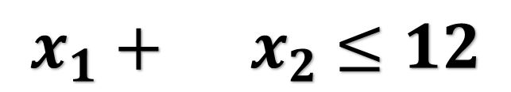
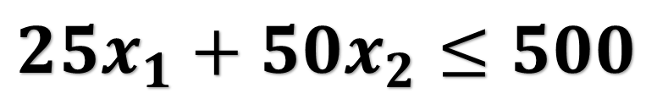
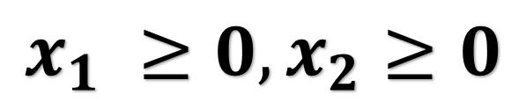
Constraints:
There are two constraints, one for investment amount and the other for Storage Capacity.
Investment Constraint
$$25x_{1}+50x_{2}≤500$$
Space Constraint
$$x_{1} +{ x}_{2} ≤12$$
Non-Negativity Constraint
$$x_{1} ≥0,x_{2}≥0$$

Slide 9
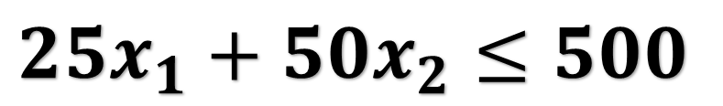
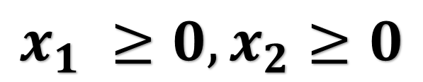
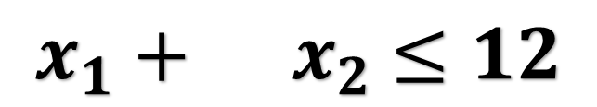
Finally the LPP Model is
$$Maximize Z=6x_{1}+10x_{2}$$
Subject to
$$25x_{1}+50x_{2}≤500$$
$$x_{1} +{ x}_{2} ≤12$$
$$x_{1} ≥0,x_{2}≥0$$

Slide 10
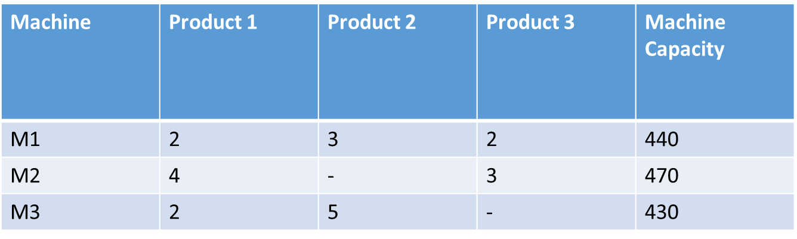
EXAMPLE 2 (Production Allocation Problem)
A firm produces three products. These products are processed on three different machines. The time required to manufacture one unit of each of the three products and the daily capacity of the three machines are given in the table below.

Slide 11
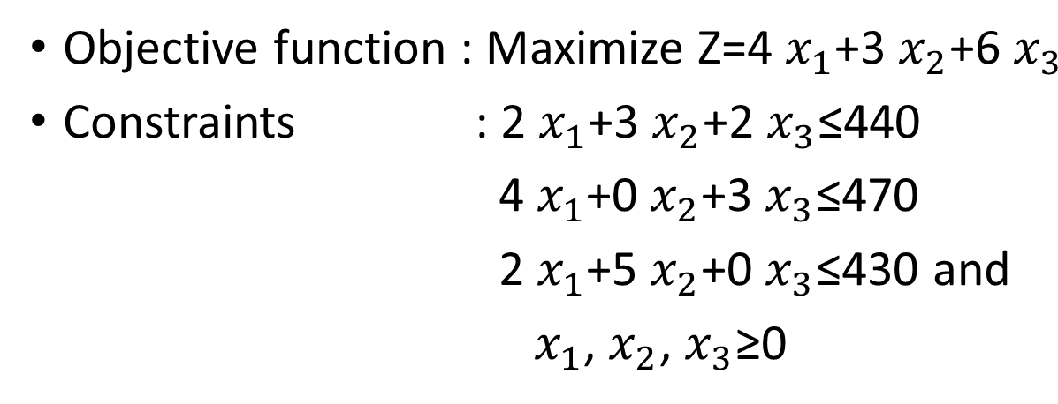
It is required to determine the daily number of units to be manufactured for each product. The profit per unit for product 1,2 and 3 is Rs. 4 Rs. 3 and Rs. 6 respectively. It is assumed that all the amounts produced are consumed in the market. Formulate the mathematical (LP) model that will maximize the daily profit

Slide 12
Example 3 (Diet Problem)
A person wants to decide the constituents of a diet which will fulfil his daily requirements of proteins, fats and carbohydrates at the minimum cost. The choice is to be made from four different types of foods. The yields per unit of these foods are given in table.
Table
Food Type | Proteins | Fats | Carbohydrates | Cost per unit
1 | 3 | 2 | 6 | 45
2 | 4 | 2 | 4 | 40
3 | 8 | 7 | 7 | 85
4 | 6 | 5 | 4 | 65
Minimum Requirement | 800 | 200 | 700

Slide 13
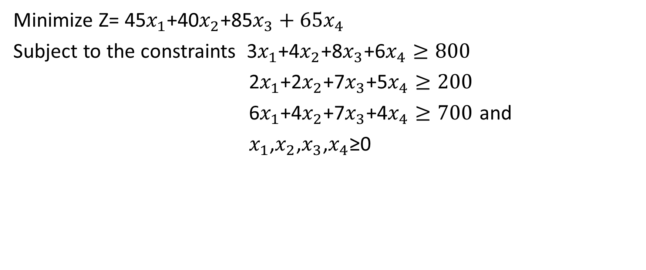
Formulation of LP Model
Minimize Z= 45$x_{1}$+40$x_{2}$+85$x_{3}+{65x}_{4}$
Subject to the constraints 3$x_{1}$+4$x_{2}$+8$x_{3}$+6$x_{4}≥800$
2$x_{1}$+2$x_{2}$+7$x_{3}$+5$x_{4}≥200$
6$x_{1}$+4$x_{2}$+7$x_{3}$+4$x_{4}≥700$ and
$x_{1}$,$x_{2}$,$x_{3}$,$x_{4}$≥0

Slide 14
Example 4
A company has two grades of inspectors 1 and 2, the members of which are to be assigned for a quality control inspection. It is required that at least 2000 pieces be inspected per 8-hour day. Grade 1 inspectors can check pieces at the rate of 40 per hour, with an accuracy of 97 percent. Grade 2 inspectors check at the rate of 30 pieces per hour with an accuracy of 95 percent. The wage rate of a Grade 1 inspector is Rs 5 per hour while that of a Grade 2 inspector is Rs 4 per hour. An error made by an inspector costs Rs 3 to the company. There are only nine Grade 1 inspectors and eleven Grade 2 inspectors available to the company. The company wishes to assign work to the available inspectors so as to minimize the total cost of the inspection. Formulate as an LP model so as to minimize the daily inspection cost.

Slide 15
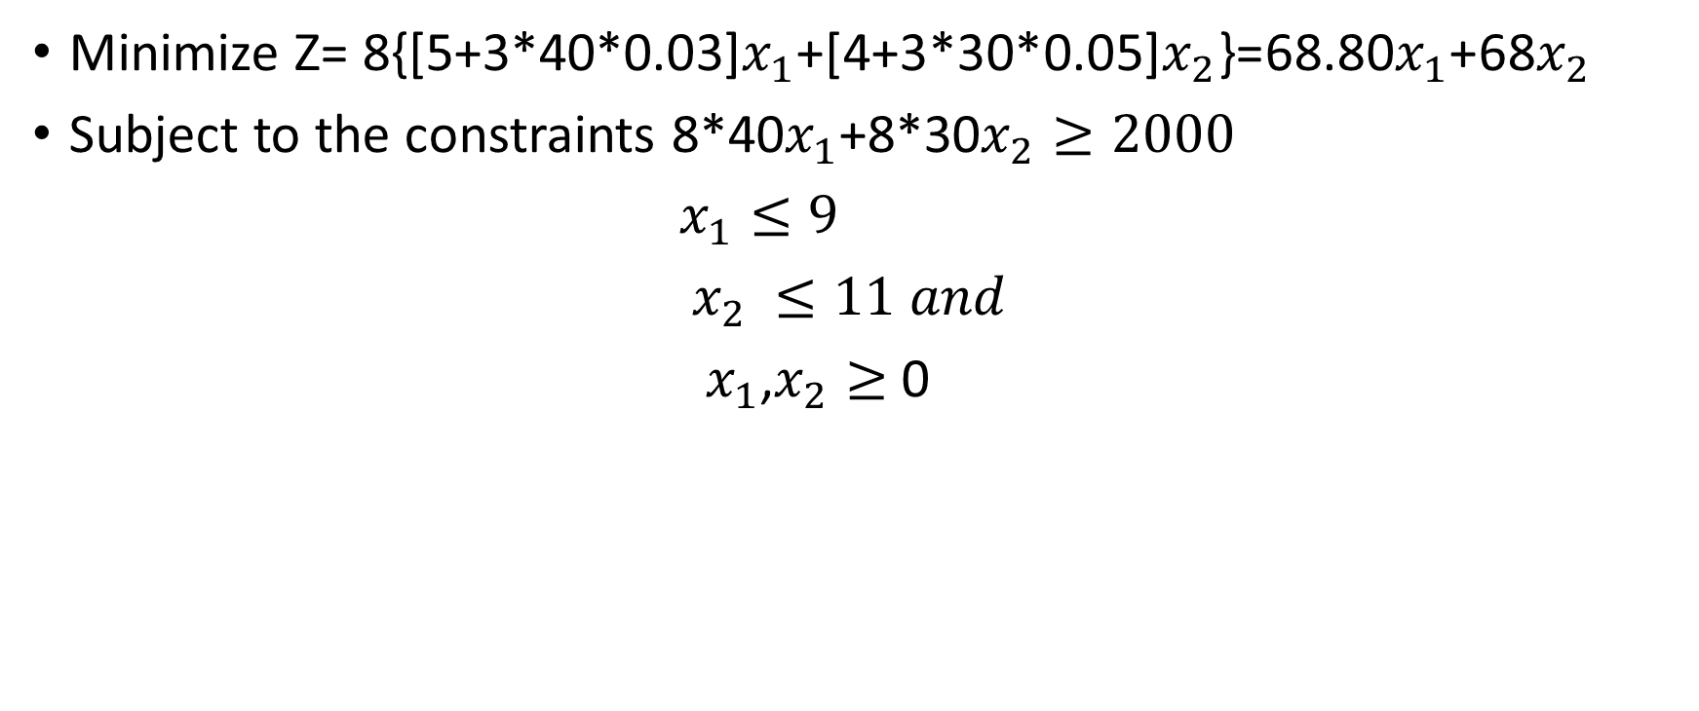
LP Model
Minimize Z= 8{[5+3*40*0.03]$x_{1}$+[4+3*30*0.05]$x_{2}$}=68.80$x_{1}$+68$x_{2}$
Subject to the constraints 8*40$x_{1}$+8*30$x_{2}≥2000$
$x_{1}≤9$
$x_{2}$ $≤11 and$
$x_{1}$,$x_{2}≥$ 0

Slide 16
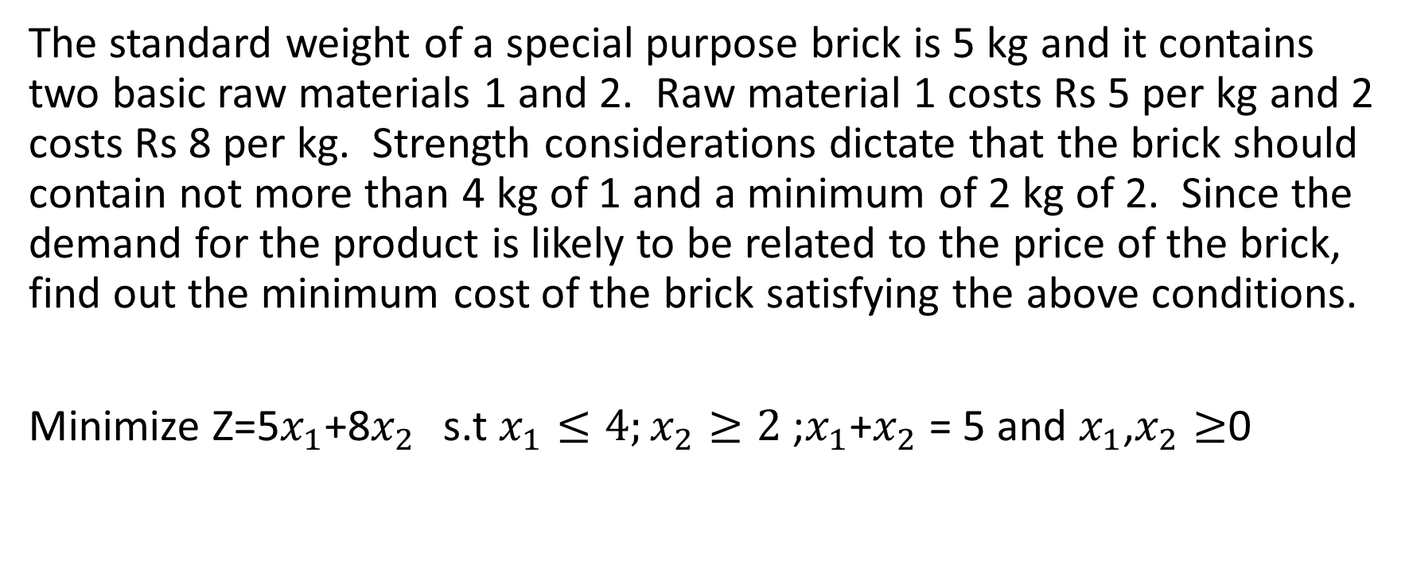
Example 5
The standard weight of a special purpose brick is 5 kg and it contains two basic raw materials 1 and 2. Raw material 1 costs Rs 5 per kg and 2 costs Rs 8 per kg. Strength considerations dictate that the brick should contain not more than 4 kg of 1 and a minimum of 2 kg of 2. Since the demand for the product is likely to be related to the price of the brick, find out the minimum cost of the brick satisfying the above conditions.
Minimize Z=5$x_{1}$+8$x_{2 }$ s.t $x_{1}≤4;x_{2}≥2$ ;$x_{1}$+$x_{2}$ = 5 and $x_{1}$,$x_{2}≥$0

